Slide 1




Slide 2

Cell Nuclei Segmentation
Implementation and Evaluation
of Otsu Thresholding
Project Proposal
Topic 01: Biomedical Image Analysis
Supervisor: Dr. Karl Rohr, Christian Ritter, Tutor: Marie Becker
Group 01.04: Maribel Schneider, Marie-Claire Indilewitsch, Helen Jade, Ieva Sorokina-Ozola
Date: 18.05.2022

Slide 3
Overview
Data
Challenges and ideas
Project management
Procedure

Slide 4

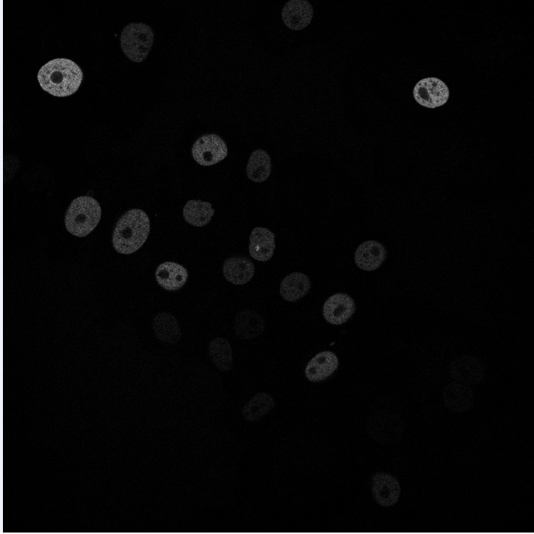
N2DH-GOWT1 Cell type: embryonic stem cells | Organism: Mouse (Mus musculus)
Stained with GFP
6 images total
1024x1024 pixels
10-20 nulei per image
GOWT1 – stem cell line

Slide 5
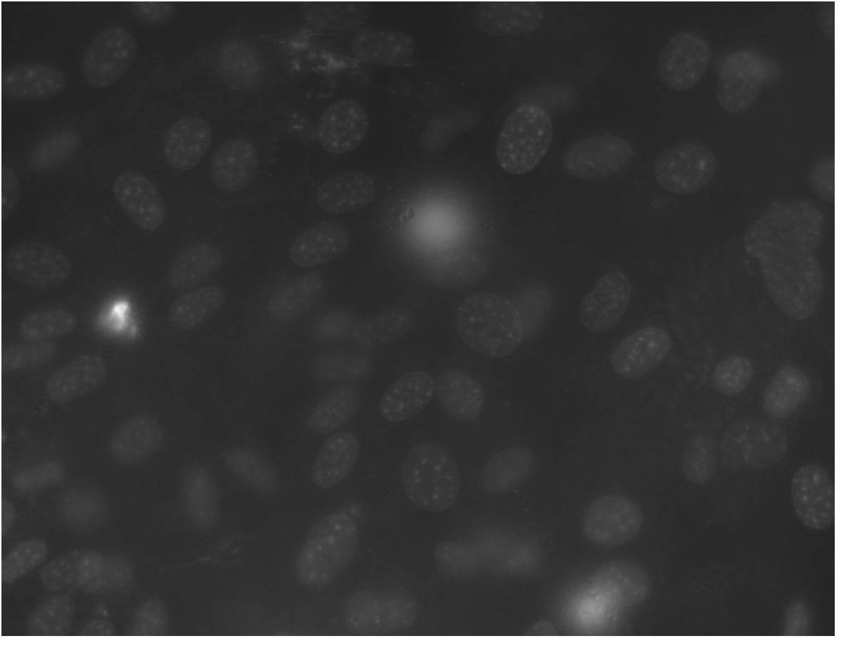
NIH3T3 Cell type: Embryonic fibroblast cells | Organism: Mouse (Mus musculus)
Stained with Hoechst
18 images total
Size: 1344x1024 pixels
about 60 nuclei per image

Slide 6

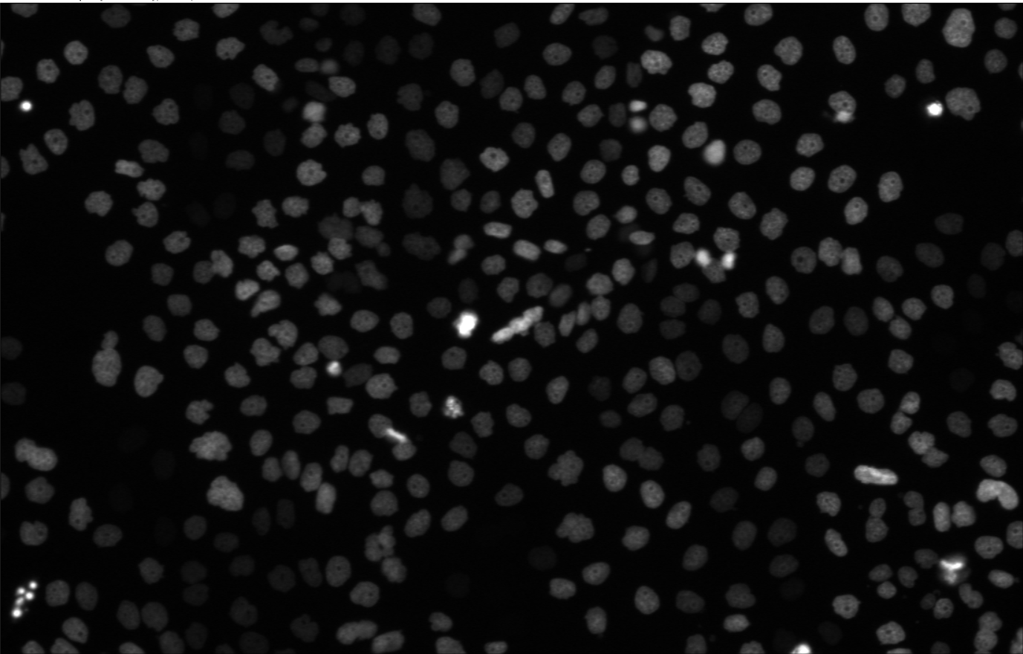
N2DL-HeLa Cell type: Cervix carcinoma cells | organism: human (Homo sapiens)
Stained with GFP
4 images total
Size: 1100x 700 pixels
30-50 nuclei per image

Slide 7
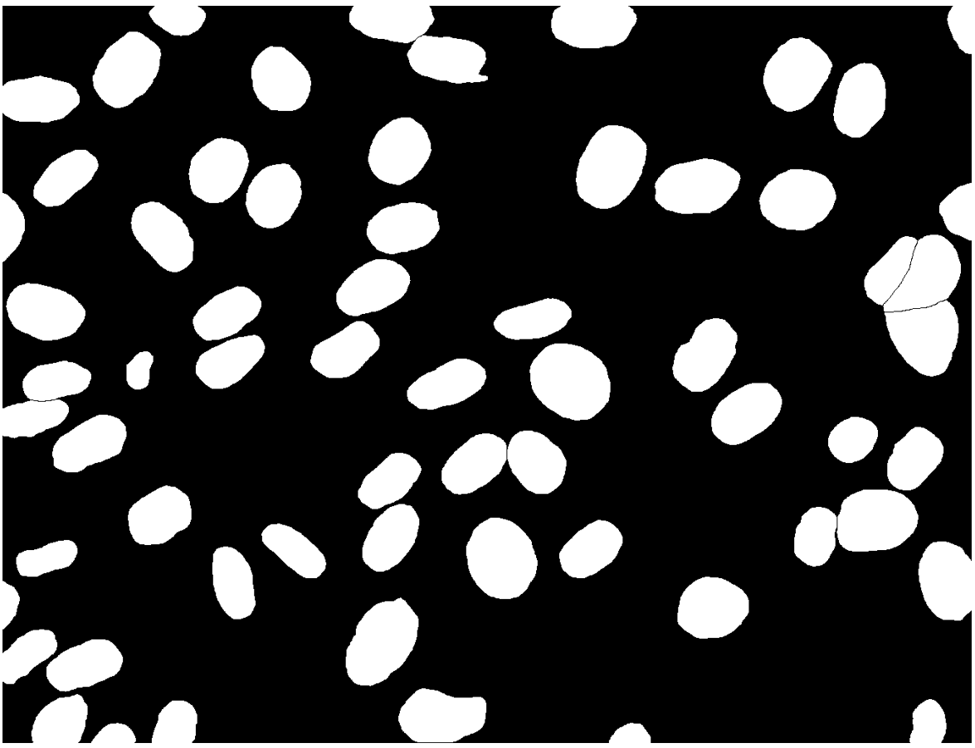
Image
Ground Truth

Slide 8



Procedure
Input image
Preprocessing
Otsu Thresholding
Dice Score

Slide 9
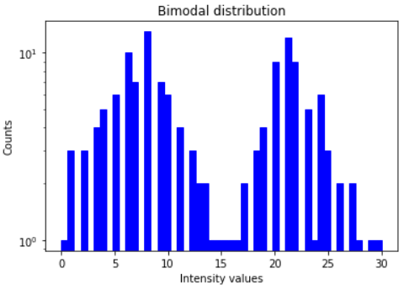
Otsu Thresholding

Slide 10
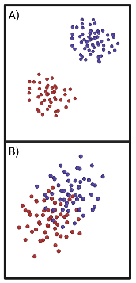
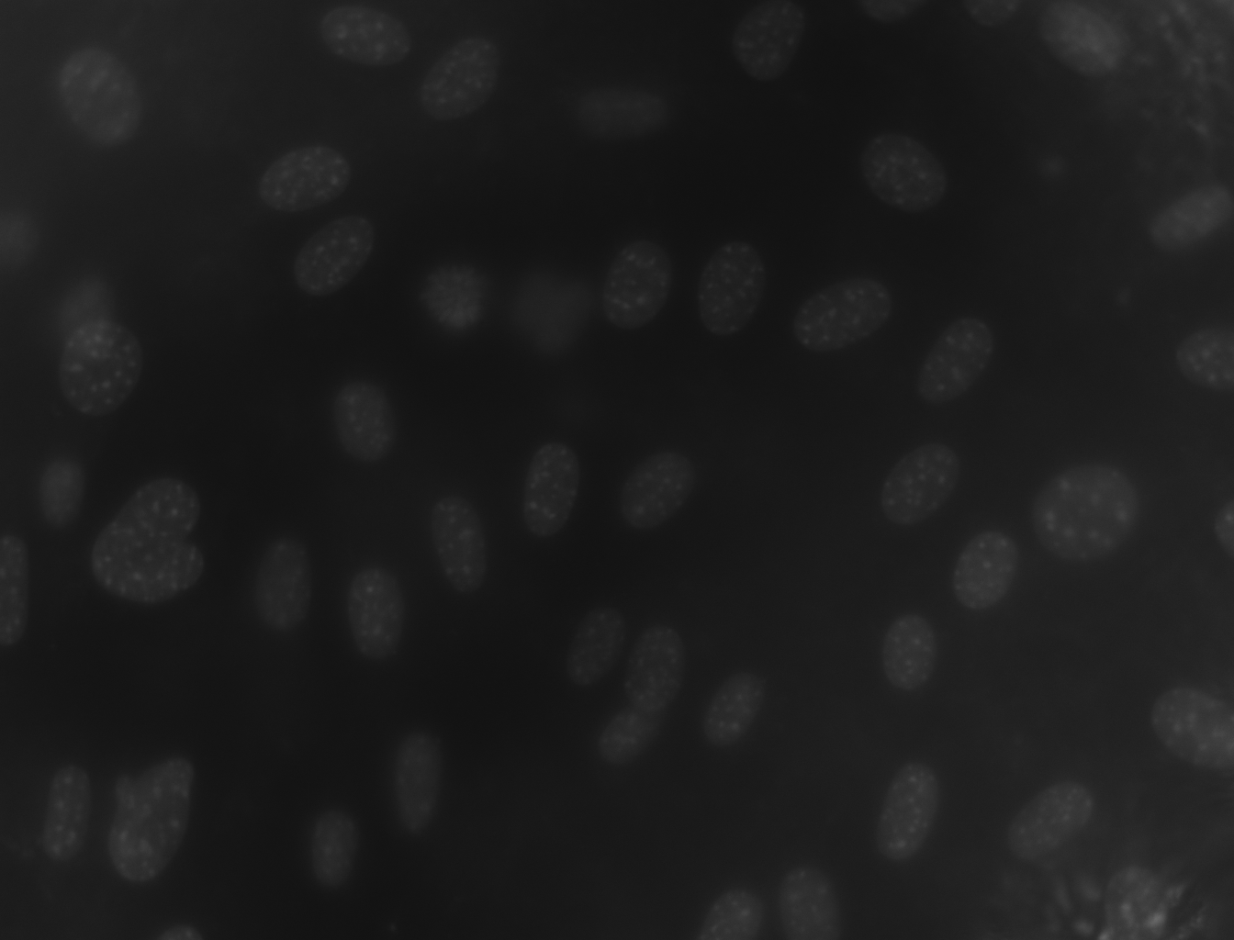
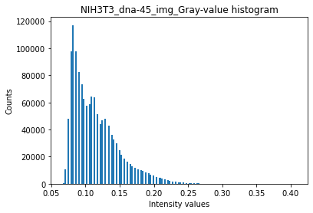
Otsu Thresholding

Slide 11


Otsu Thresholding
Determintation of the optimal threshold value by maximizing the between-class variance or equivalently minimizing the the within-class variance
Between-class variance
$σ_{b}^{2}=ω_{0}ω_{1}\left(μ_{1}−μ_{0}\right)$²
$ω_{0,1}$ = Probabilities of class occurrence
$μ_{0,1}$ = Class mean levels
Within-class variance
$$σ_{w}^{2}=ω_{0}σ_{0}^{2}+ω_{1}σ_{1}^{2}$$
$ω_{0,1}$ = Probabilities of calss occurrence
$σ_{0,1}^{2}$= Class variances

Slide 12
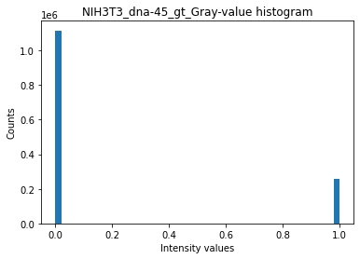
Otsu Thresholding
$$g_{seg}\left(x,y\right)=\left\{\begin{aligned}0 if g\left(x,y\right)≤t \\ 255 if g\left(x,y\right)>t\end{aligned}\right.$$
𝑔_𝑠𝑒𝑔 (𝑥,𝑦)={█(0 𝑖𝑓 𝑔(𝑥,𝑦)≤𝑡@255 𝑖𝑓 𝑔(𝑥,𝑦)>𝑡)┤

Slide 13




Otsu Thresholding - Algorithm
Input image
Image histogram, P(i)
Set up initial $ω_{i}\left(0\right)$ and $μ_{i}\left(0\right)$
Set up initial 𝜔_𝑖 (0) and 𝜇_𝑖 (0)
Update values of $ω_{i}$(t) and $μ_{i}$(t)
Update values of 𝜔_𝑖(t) and 𝜇_𝑖(t)
Compute variances $σ_{b}^{2}$ and $σ_{w}^{2}$
Compute variances 𝜎_𝑏^2 and 𝜎_𝑤^2
Select threshold intensity t
Image clipping
Output image

Slide 14

Optimisation algorithm – Dice score
~ 80% Accuracy

Slide 15
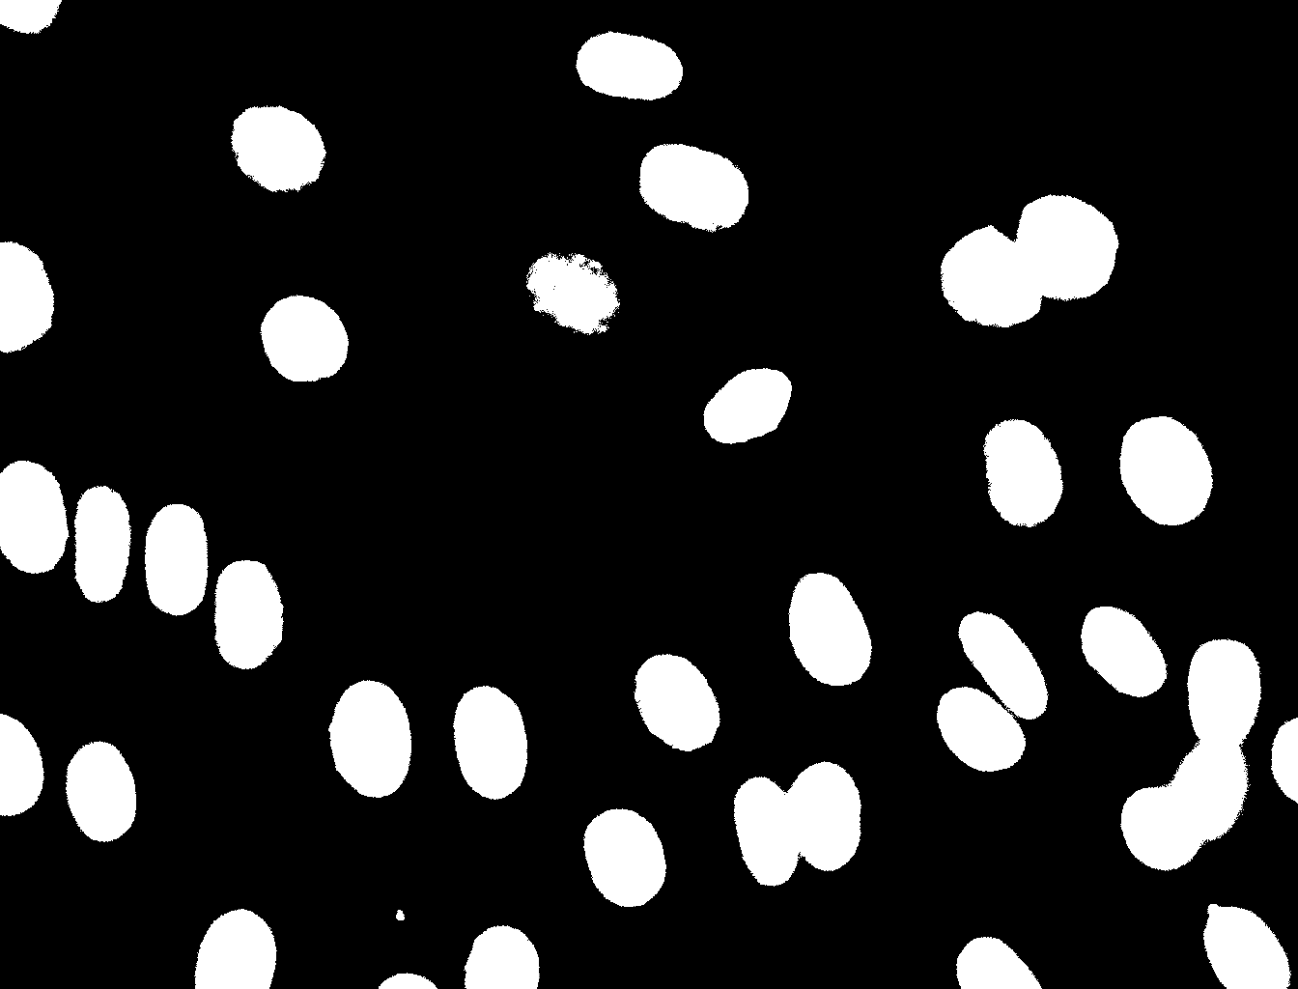
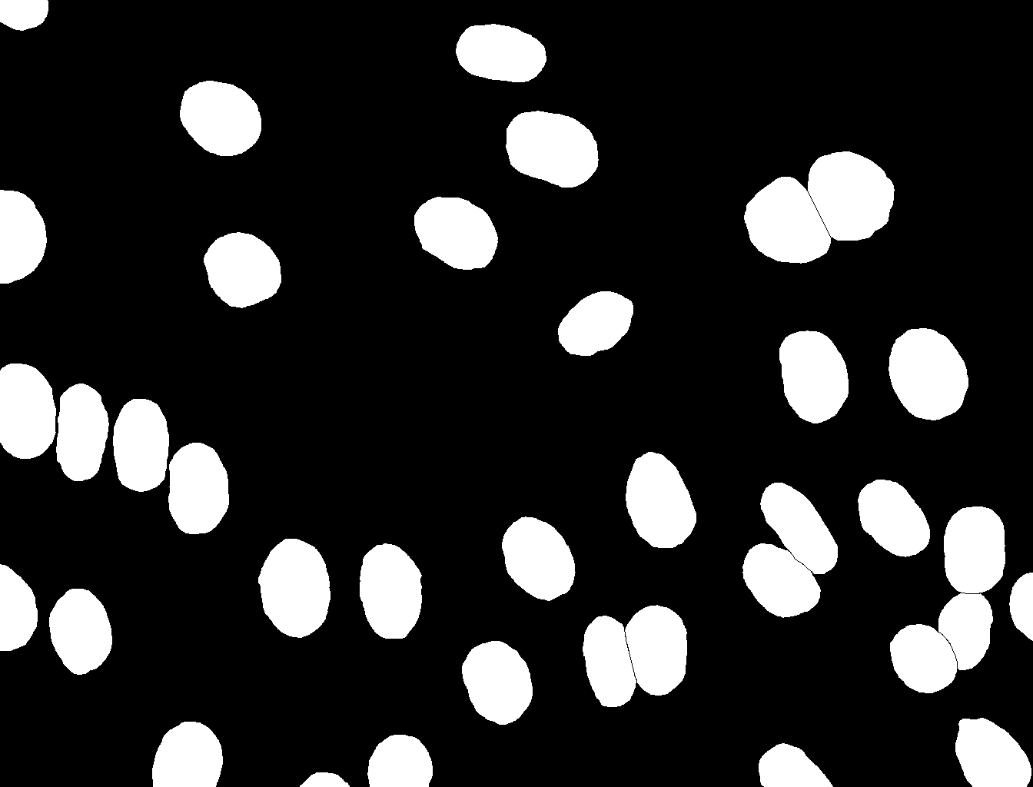
Dice Score Coefficient
Kurzerklaerung was TP, FP usw ist also
gt = ground truth; pt = post tresholding
TP : Both pixels white
FP : gt pixel black, pt pixel white
TN : both pixels black
FN : gt pixel white, pt pixel black
Tresholding using online tool
( imageonline.co)
Ground truth picture

Slide 16


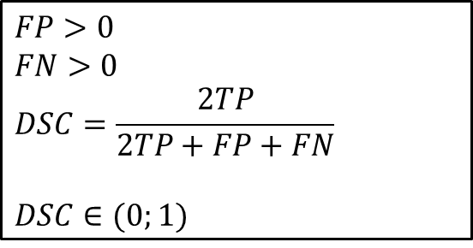
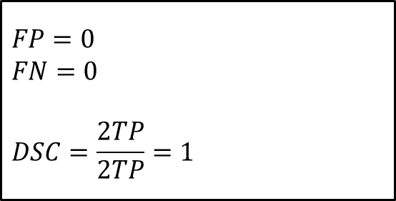
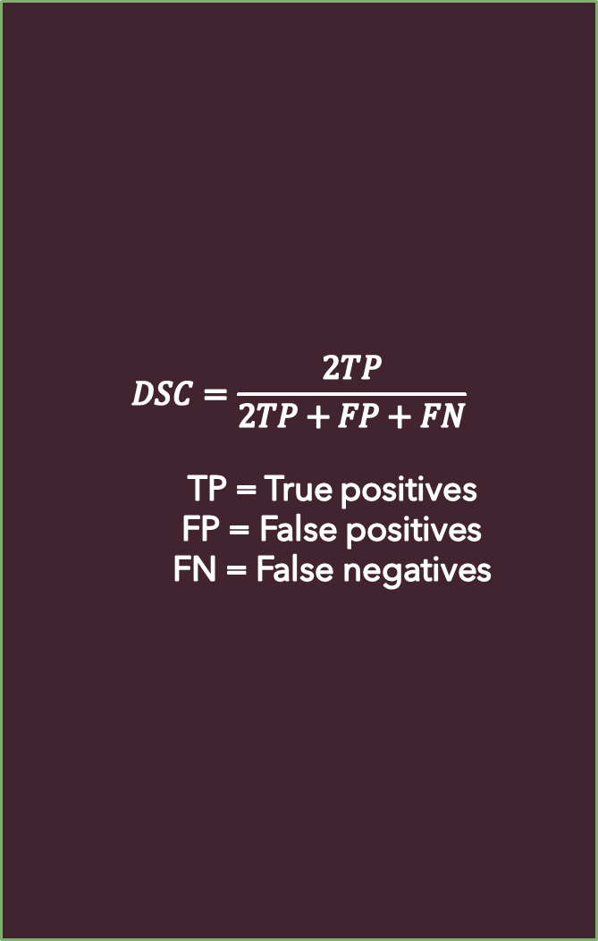
Dice Score
$$DSC=\frac{2TP}{2TP+FP+FN}$$
TP = True positives
FP = False positives
FN = False negatives
Post Otsu = Ground truth
$$FP=0$$
$$FN=0$$
$$DSC=\frac{2TP}{2TP}=1$$
TP
Ground truth
$$FP>0$$
$$FN>0$$
$$DSC=\frac{2TP}{2TP+FP+FN}$$
$$DSC∈(0;1)$$
FN
TP
FP
Post Otsu

Slide 17



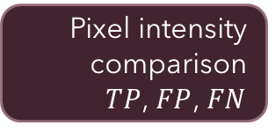
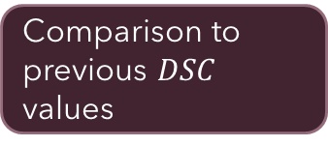
Dice score - Implementation
Iteration over gt and tresholded pictures
Algorithm optimisation
Pixel intensity comparison
$TP$, $FP$, $FN$
Comparison to previous $DSC$ values
$DSC$ computing
and storing

Slide 18



Dice score - Issues

Slide 19

Challenges: N2DH-GOWT1
Noise
Holes
Low contrast
https://threshold.imageonline.co/

Slide 20
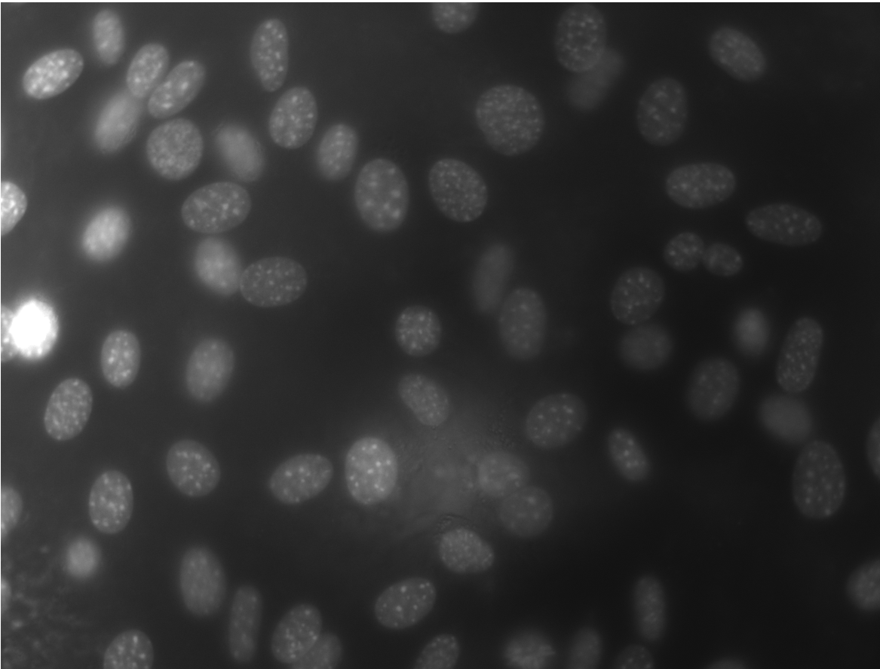
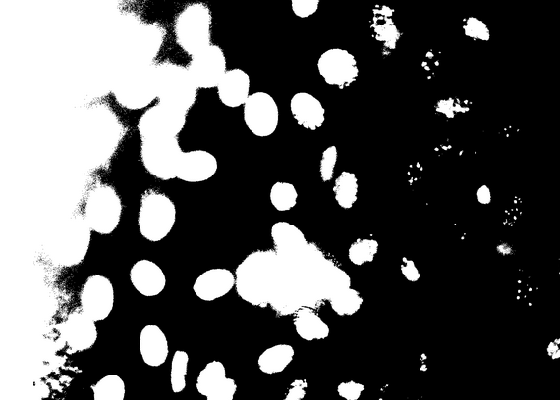
Challenges: NIH3T3
Brightness
Reflection
https://threshold.imageonline.co/

Slide 21
Solution ideas
Challenge | Solution
Noise | Gaussian filter, median filter
Holes | Median filter
Low contrast | Histogram stretching
Reflections | Thresholding
Brightness | Local thresholding

Slide 22
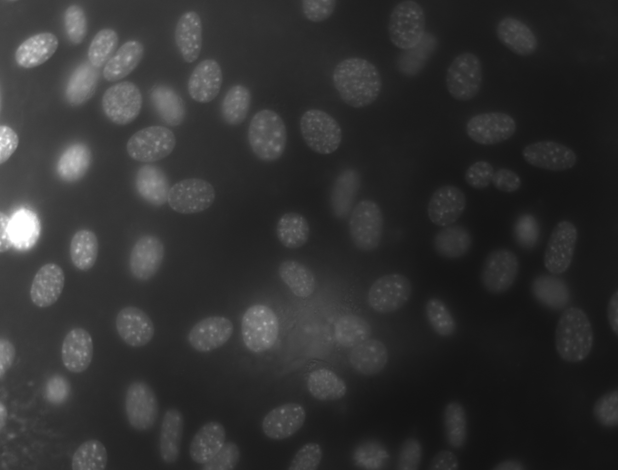
Local Thresholding - Sliding window scheme

Slide 23



Timeline
First steps
Final presentation
Local threshold
Otsu and Dice
10.05.
31.05.
14.06.
Buffer and report
28.06.
21.06.
17.05.
07.06.
Cell counting
Alternative evaluation methods and further ideas
Project proposal
Preprocessing and testing

Slide 24
Milestones and Deliverables
First steps
Plan and organize team
Read resources and understand data
Propject proposal
Visualize data and understand algorithms
Otsu and Dice
Implement Otsu thresholding and dice score
Finish project proposal
Test it on data

Slide 25

Preprocessing and testing
Implement different preprocessing features
Test pipeline on optimized images
Local threshold
Impement sliding window scheme
Alt. evaluation methods and further ideas
Implement further evaluation methods
Cell counting
Implement cell counting algorithm
Implement two-level-Otsu
Final weeks:
Finished report
Cleaned up GitHub
Collab with other group

Slide 26
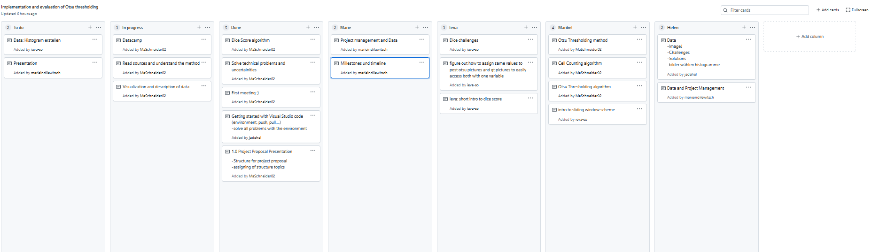



Team
Meetings
Teamwork
GitHub
2x a week
Live and online
Use project feature
Strucuture repository
Work in pairs
Help each other

Slide 27

Extra slides

Slide 28
Challenges: N2DL-HeLa
Bild wo man reflections sieht…

